Slide 1
An Introduction to the Tidyverse
Course Summary
* All graphics shown in this presentation can be made using skills taught in this course with just a few lines of code and a spare ten minutes

Slide 2
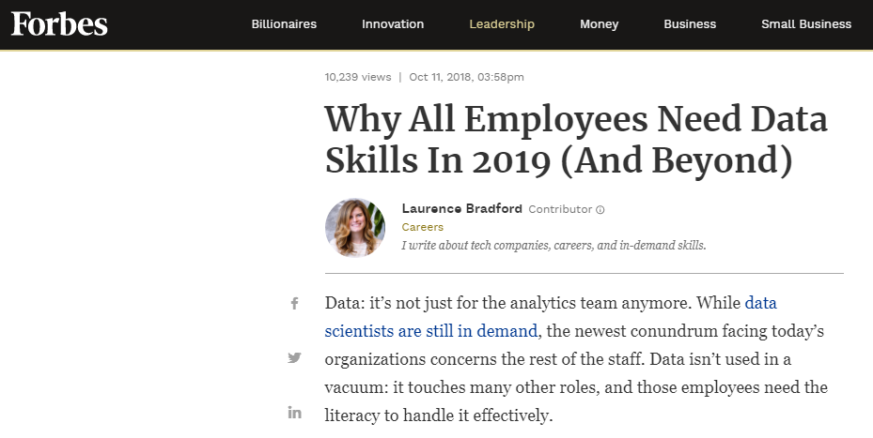
Data skills are in high demand…
Data is everywhere:
Biology
Chemistry
Economics
Finance
Journalism
Law
Management
Marketing
Engineering

Slide 3
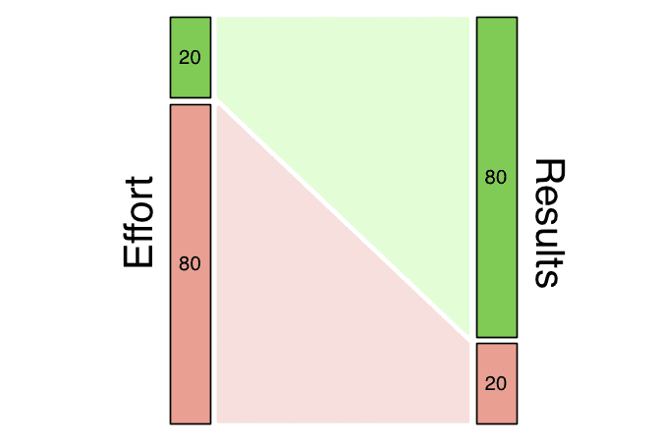
The Pareto principle:
80% of all problems can be solved by knowing 20% of a topic
This course teaches you that 20%

Slide 4
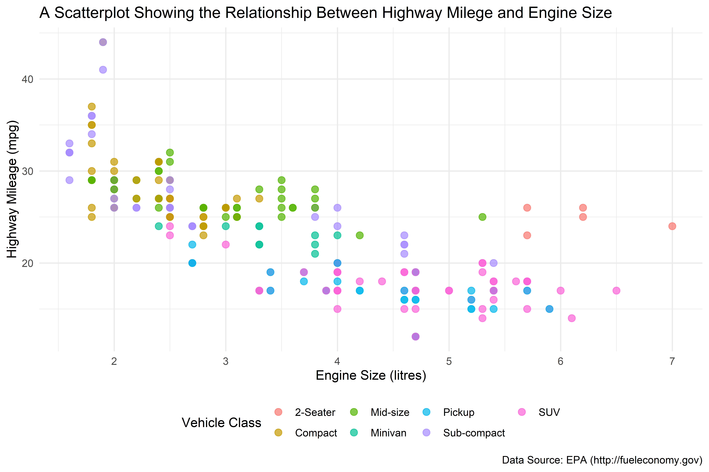
Session 1 – Basic Visualisation
Learn how to make a data visualisation from scratch

Slide 5
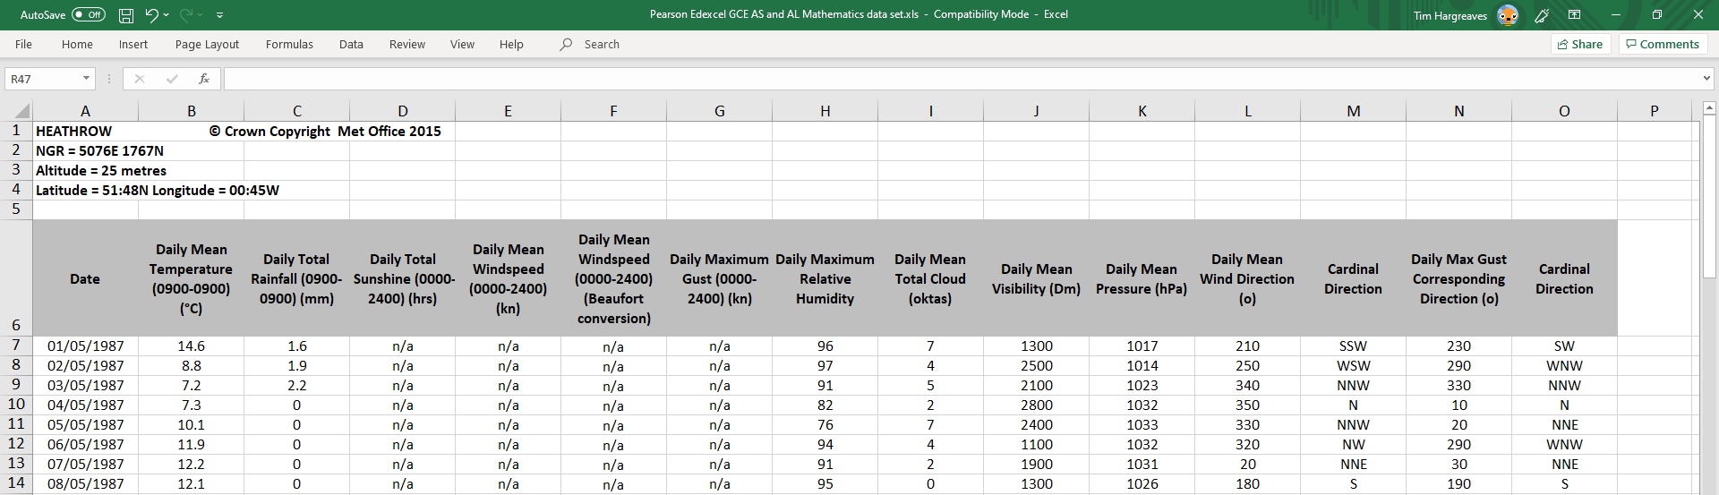
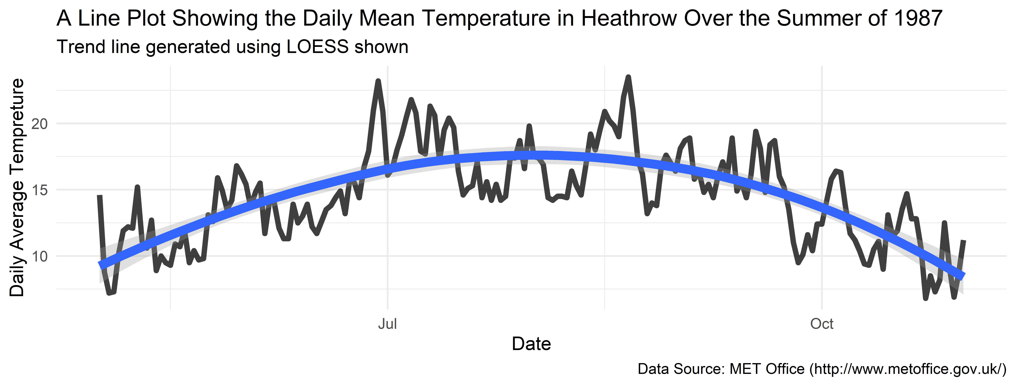
Session 2 – Data Import
Extract data from text files, Excel spread-sheets, or from the web

Slide 6
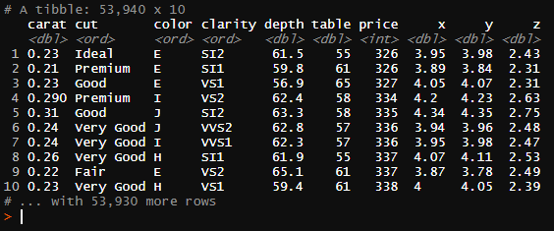
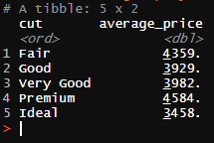
Session 3 – Data Manipulation
Take a data set and use it to answer questions
An extract from the diamonds dataset
Question: What is the average price of each cut of diamond?
Result of manipulation

Slide 7
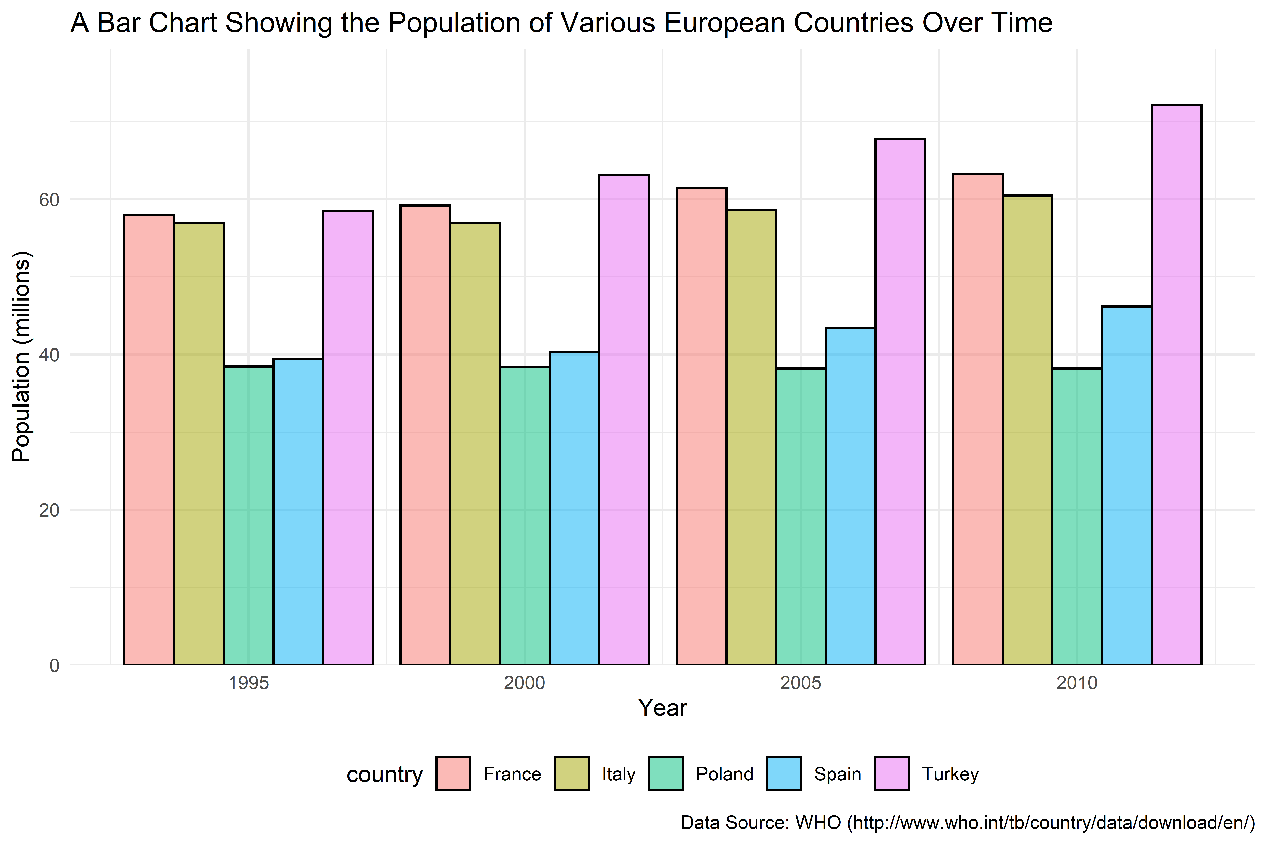
Session 4 – Data Tidying
Take a dataset and tidy it into a form that is easier to answer questions with

Slide 8
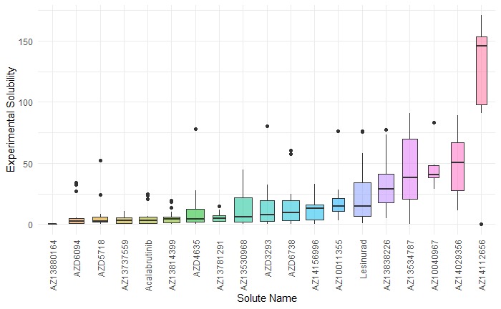
Session 5 – Advanced Plotting
Learn to create all sorts of weird and wonderful visualisations
Example from my recent work in Chemical Development at AstraZeneca – data is not just for Mathematicians!

Slide 9
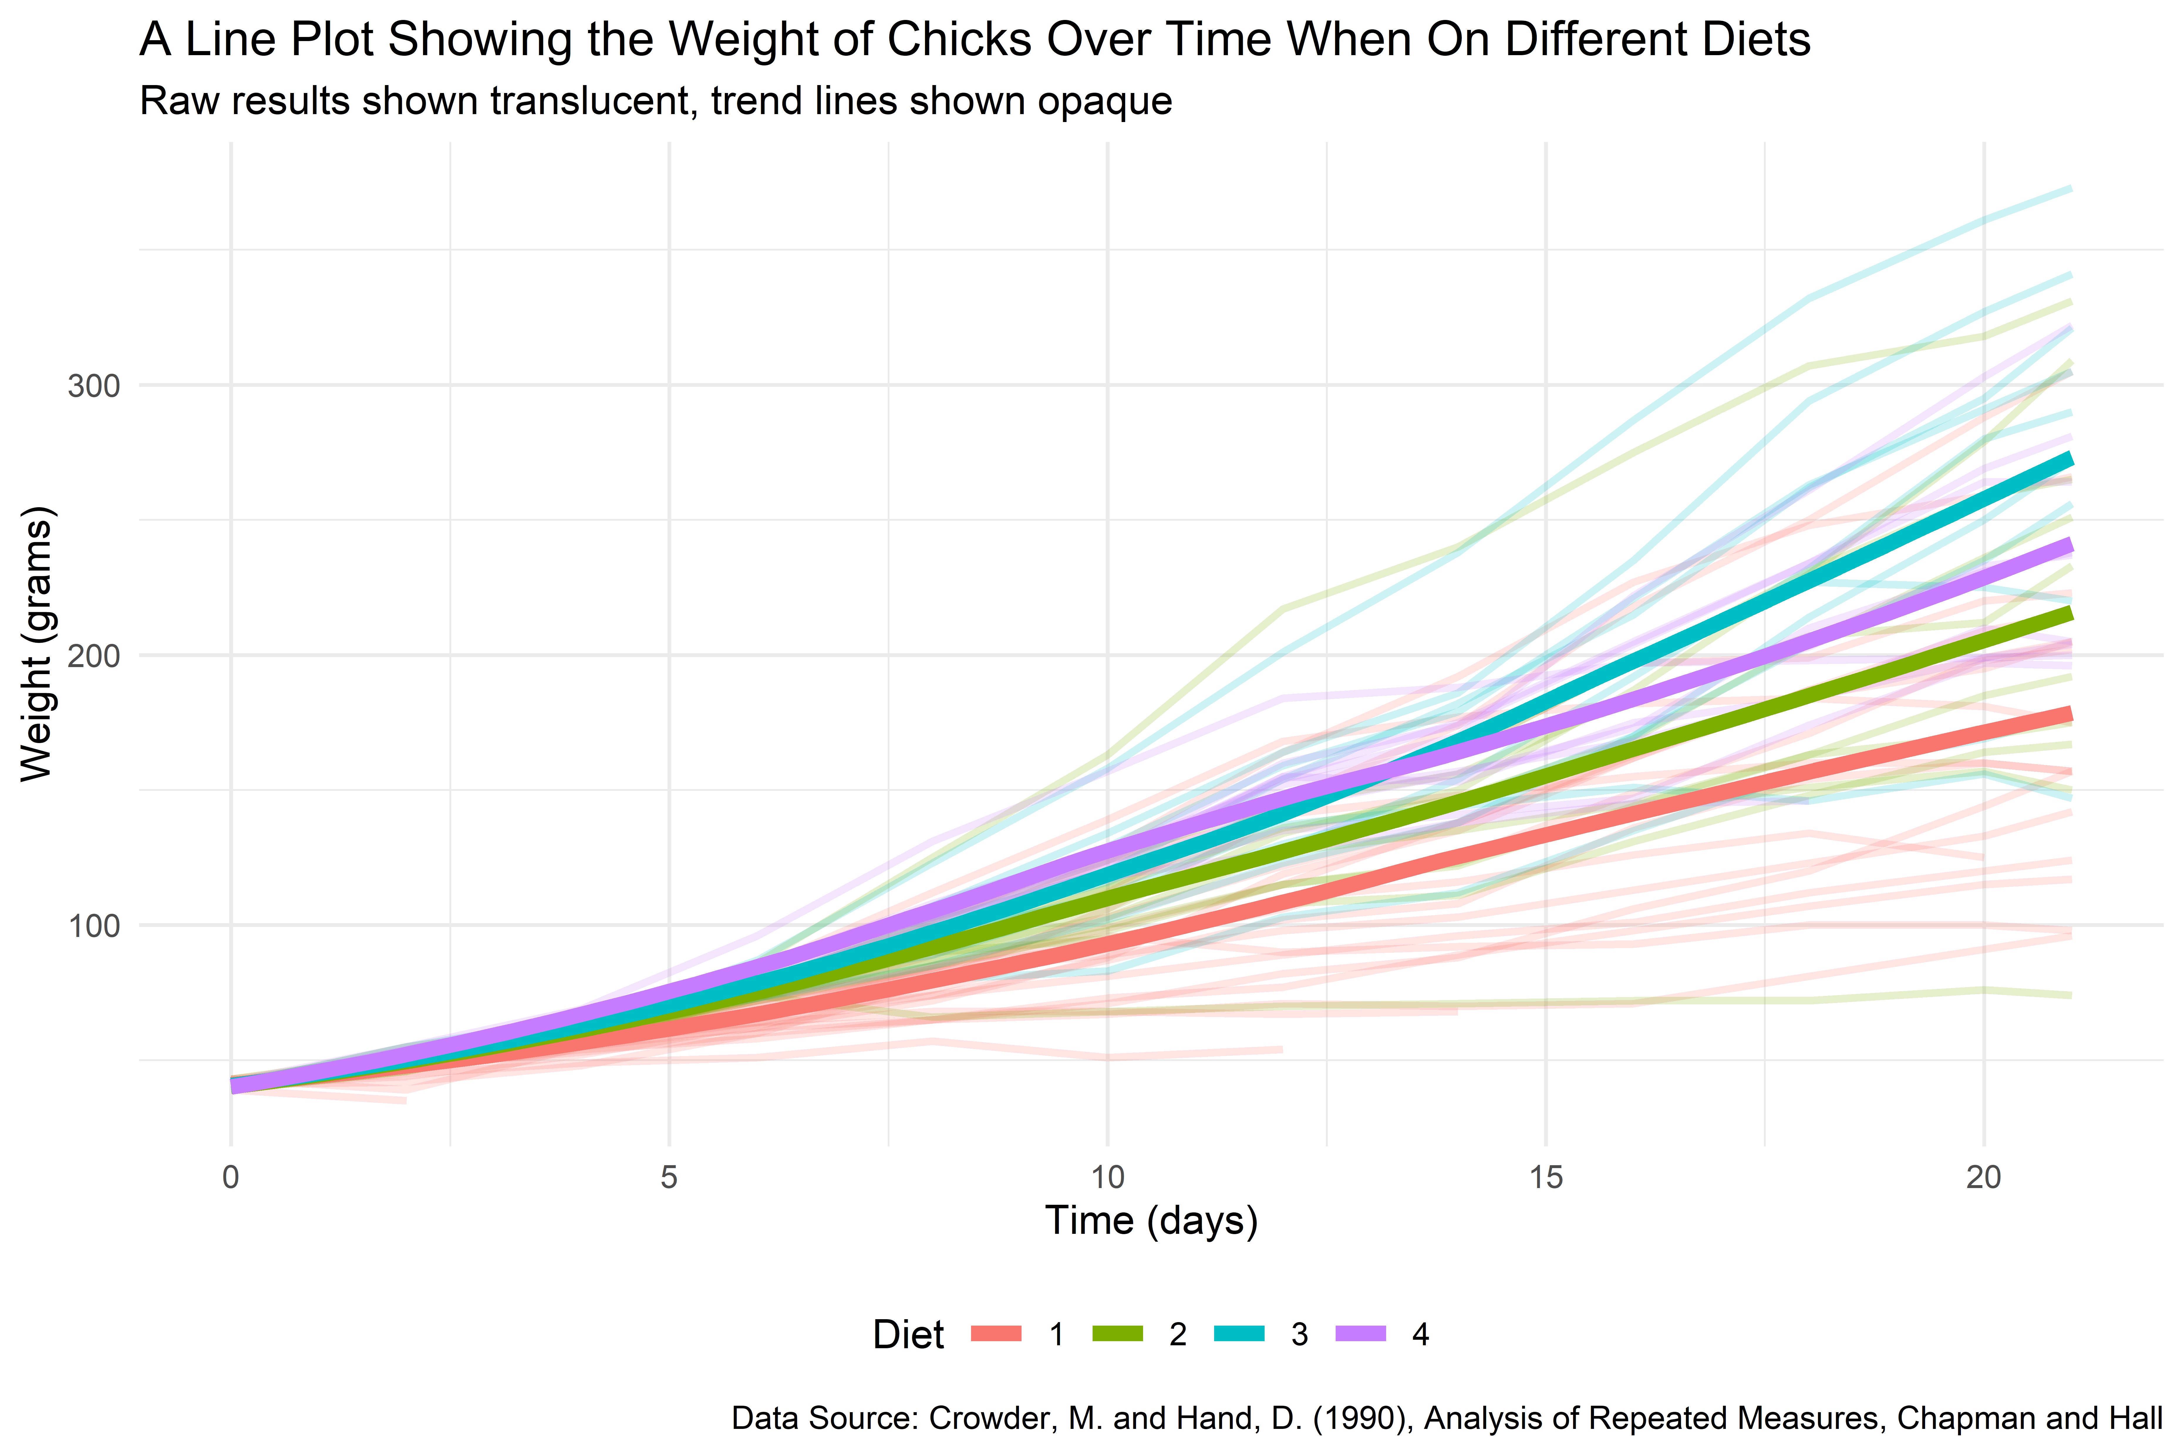
Session 6 – DataViz Battle
Showcase your skills by building your own data visualisation on any dataset you want - (with help if needed)
Prizes for participation and category winners!

Slide 10
Thank You
Questions: tim.Hargreaves@icloud.com

